Slide 1
QECO/COEQ The Qualifications Evaluation Council of Ontario Presentation For 2016 Graduating Teacher Candidates at Ontario Teacher Education Institutions January, 2016

Slide 2
QECO: AN OVERVIEW
What is QECO?
Initial Evaluation after OCT Certification
Upgrading as a Member of an Affiliate

Slide 3
WHAT IS QECO?
QECO is:
A creation of the three affiliates AEFO, ETFO and OECTA
Evaluates teacher academic credentials for salary purposes
Required by all Ontario boards for salary grid placement
Identified in all collective agreements across the province – jointly accepted by employers and employees
A free service to eligible certified Ontario teachers

Slide 4
WHAT QECO IS
A Credentials Evaluator
The only credentials evaluator authorized to provide category placements for members of the three affiliates, AEFO, ETFO and OECTA.
More than 40 years of service
First evaluation early 1970s
Now, more than125,000 teachers, all publicly funded boards in the province
Nearly 20,000 applications per year

Slide 5
WHAT QECO IS
For Teachers and School boards:
Negotiated in all collective agreements
Placement is consistent (Ontario only)
Qualifications are consistently recognized
Upgrading is systematic
Integrity of program is trusted by both teachers and boards

Slide 6
WHAT QECO IS
PROGRAM 5:
Qualification evaluation specific to Ontario education:
1. General Education Chart
2. Technological Education Chart
5th revision since 1969
May be viewed on website
5 Categories available to certified teachers:
A A1 A2 A3 A4
Teachers with OCT acceptable degrees, or Tech. Education teachers with basic technological Education qualifications, will be placed in no less than Category A1

Slide 7
Requirements to Obtain QECO Services
Service by QECO is usually limited to Ontario certified teachers who are members of AEFO, ETFO or OECTA.
However….
Some new teachers are eligible for an initial evaluation without teacher affiliate membership if they:
Received teacher education at an Ontario Publicly funded institution, and;
Apply to QECO within 4 months of certification.

Slide 8
General Education Applicants
DOCUMENTATION
Complete an application (available only on website)
Mail all official transcripts of all post secondary studies that you have completed including:
Ontario college of applied arts and technology (CAAT),
University (degree-granting institutions)
Teacher education
Official transcripts from any institution from which transfer credit was issued.

Slide 9
Technological Studies Applicants Required Documents
Original transcript(s) any/all Ontario Grade 13, OAC or 12U coursework completed.
Clear, unaltered photocopies with all numbers legible for all of the following qualifications from the Ontario Ministry of Training, Colleges and Universities:
Certificate(s) of Apprenticeship
Certificate(s) of Qualification
Certificate(s) of Qualification with Inter-provincial Red Seal
Original transcript(s) for any/all university degree-credit coursework completed.
Original transcript(s) for all coursework completed at an Ontario college of applied arts and technology (CAAT).

Slide 10
Ontario Faculties of Education General Studies
An evaluation uses Official Transcripts to determine:
The type and length of a degree
Number of courses
Concentrations of courses
Marks or grades
Qualifications from outside Ontario which are evaluated equitably based on current QECO evaluation standards
A QECO evaluation does not require:
Evaluations provided from other credentials agencies (i.e. WES, ICAS, ECE etc.) for international credentials.

Slide 11
General Studies Category A
Category A
Any teacher who has not completed an acceptable university degree.
Only applies to:
Some teachers without degrees who were certified prior to 1978.
Some teachers certified under special certification regulations.

Slide 12
General Studies Category A1
3-year degree (exclusive of teacher certification program)
with less than the graduating institution’s minimum B average
There are many teachers whose credentials merit Category A1.
Only requires 3 approved courses to move to next category.

Slide 13
General Studies Category A2
The vast majority of new teachers from Ontario teacher education programs hold qualifications that merit A2 or higher (more than 95%)
3-year degree (exclusive of teacher certification program)
Minimum B average
or
3-year degree (exclusive of teacher certification program)
5 full courses / 1 subject area (Minimum B average)
or
3-year degree (exclusive of teacher certification program)
8 full courses / 2 subject areas, 4 full in each (Minimum B average)
or
4-year degree (exclusive of teacher certification program)
Less than the minimum B average

Slide 14
General Studies Category A3
A 4-year degree (exclusive of teacher certification program)
Minimum B overall average
or
Satisfying the requirements of the Advanced Academic Accreditation (AAA) designation (See Program 5 at www.qeco.on.ca)

Slide 15
General Studies Category A4
A 4-year degree (exclusive of teacher certification program)
Minimum B overall average (often)
Plus (for example):
An additional degree (exclusive of teacher certification program)
Or
Additional required coursework to meet Category A4 requirements
See Program 5 at www.qeco.on.ca for more routes

Slide 16
Technological Studies Categories and Routes
Category A1:
Valid teaching certificate with one basic qualification in Technological Education.
Category A2:
Category A1 plus:
Three approved additional courses
Certificate of Qualification with Red Seal
Category A3:
Category A2 plus:
Three more approved additional courses
Category A4:
Category A3 plus:
Three further approved additional courses, one of which must be the Honour Technological Studies Specialist qualification
Three session specialist
Notes:
16

Slide 17
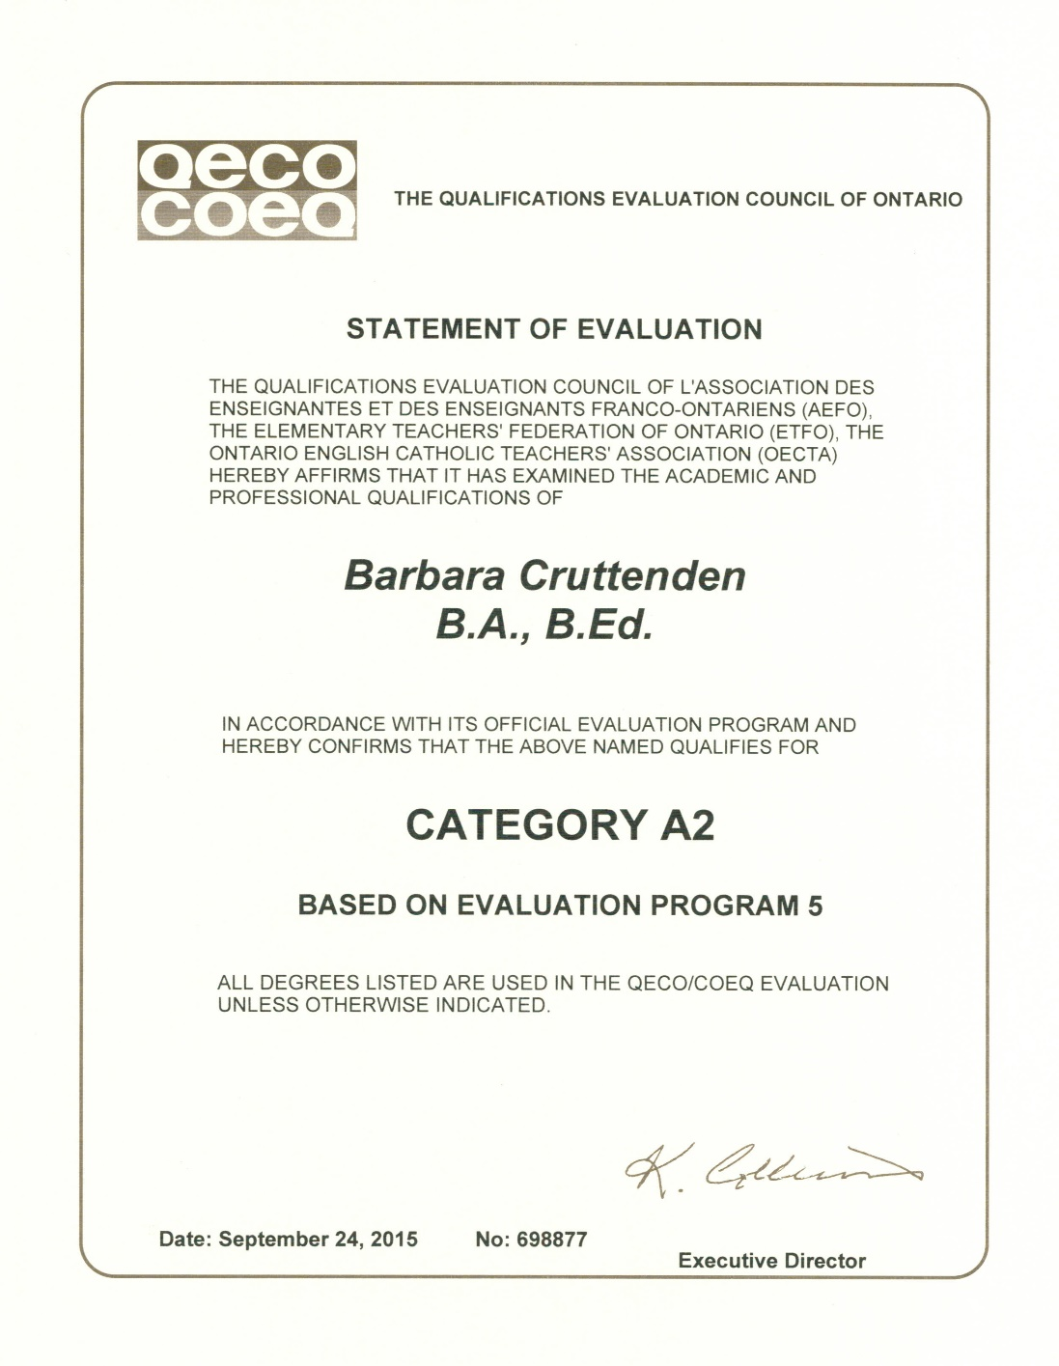
Statement of Evaluation

Slide 18
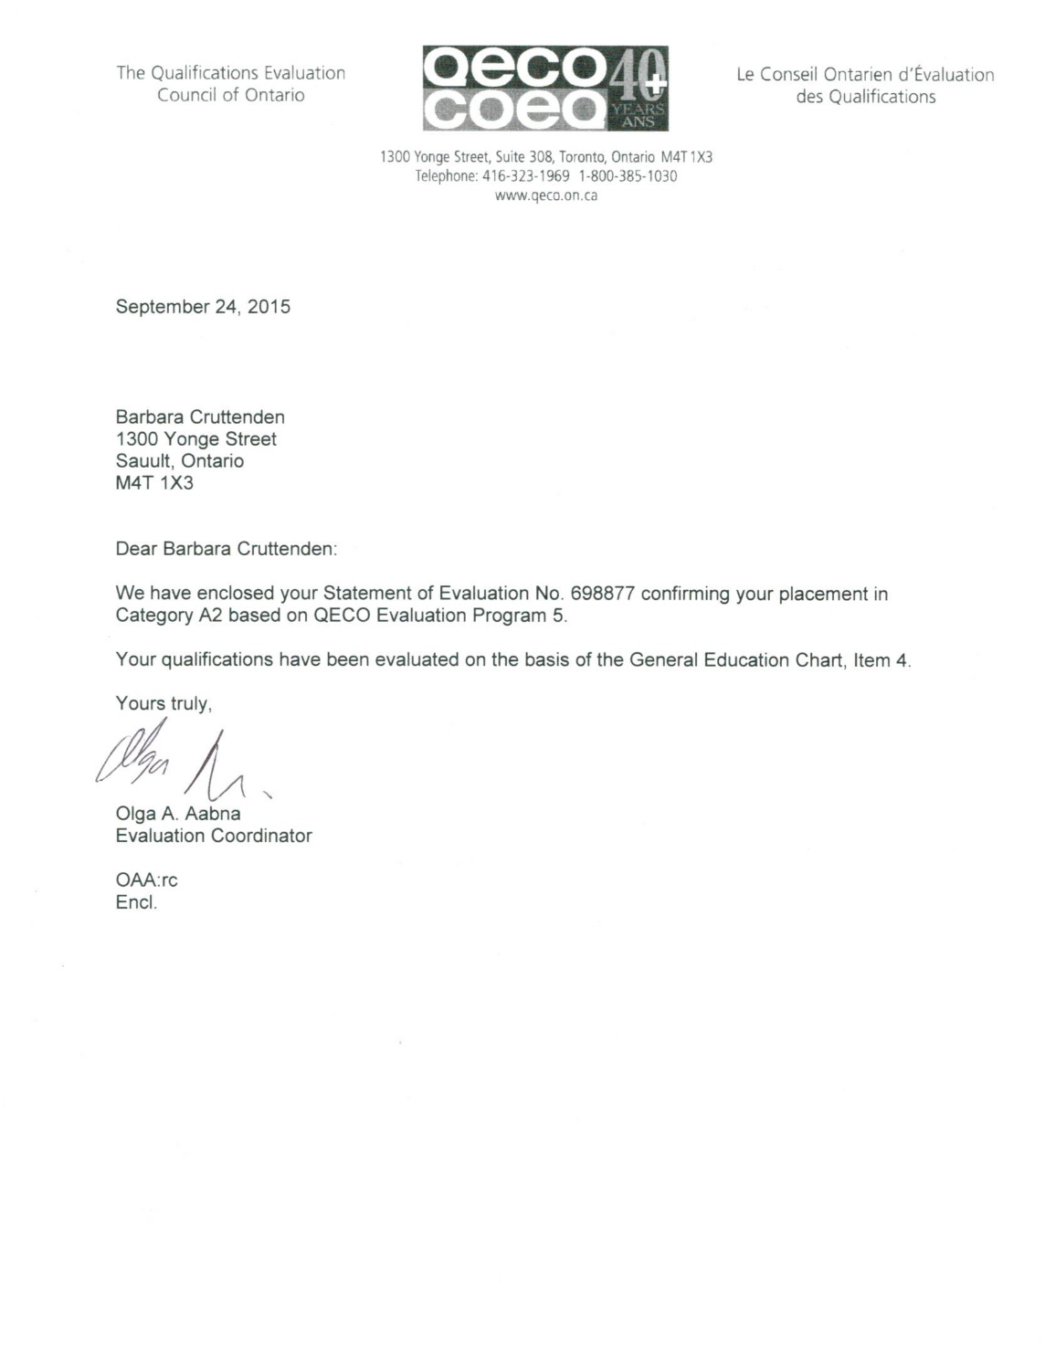
Statement Letter

Slide 19
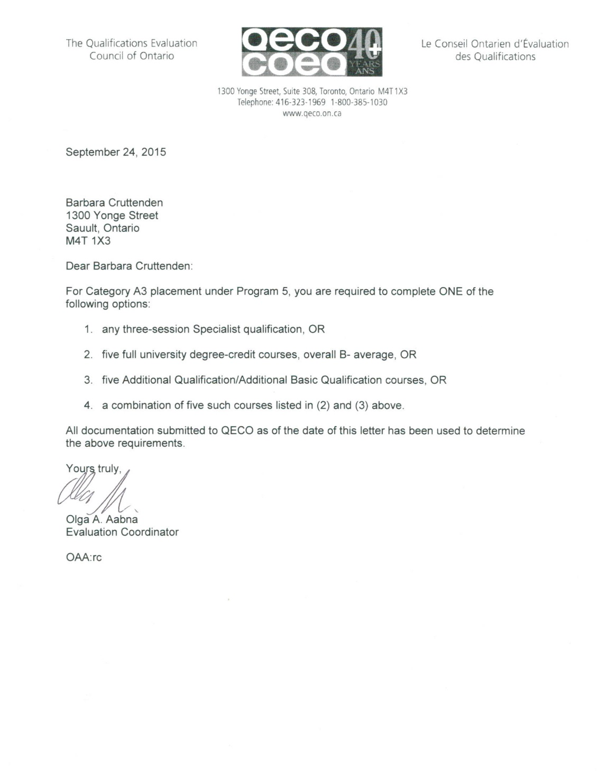
Upgrading Letter

Slide 20
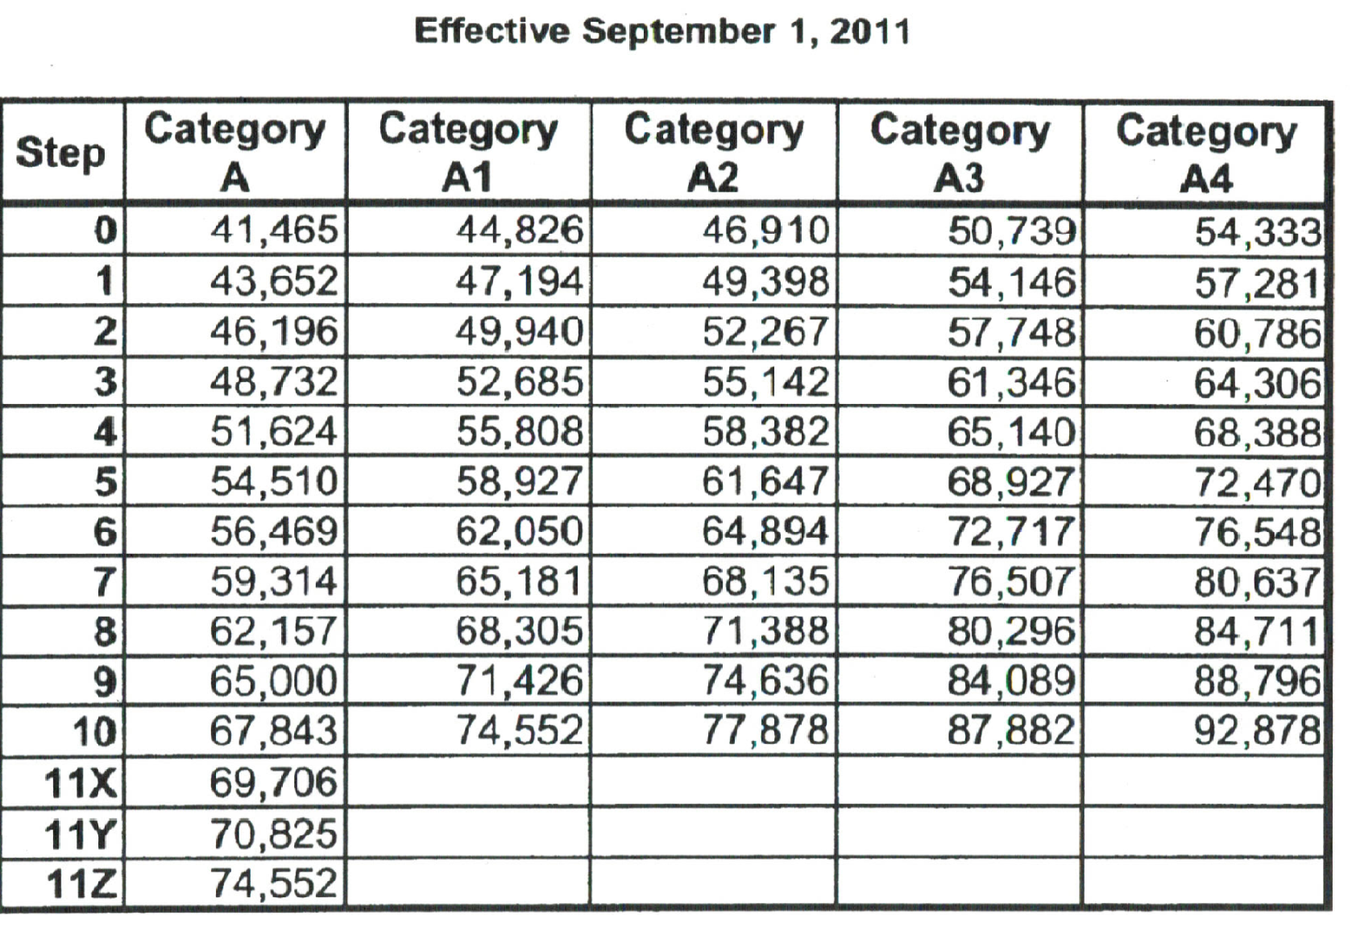
Employer’s Salary Grid and QECO Category Placement
(Only an employer may consider work experience for grid placement – check collective agreements or contact your union. Grid is for demonstration only.)

Slide 21
Common Issues
When is a QECO Statement of Evaluation required?
When a teacher begins a grid placement position.
Long Term Occasional position
Permanent full-time position
Permanent part-time position
Consult collective agreement or union for more info.
Why should I apply to QECO if I am currently unable to obtain grid placement?
To find out your current QECO placement, and then:
Re-apply for specific upgrading routes to next category
Begin working toward that next category
Advance to a higher category before beginning a grid position.

Slide 22
Common Issues
When do I submit my Statement to my Employer?
You may be asked for your QECO evaluation, along with other documents required for your HR file.
Check with your union to see if it advises that occasional teachers submit their first QECO statement of evaluation.
You want to ensure you can submit an upgraded statement when you are placed on grid.
I have several years of related work experience. Will QECO place me in a higher category?
No, QECO only evaluates academic credentials; however, school board policy or collective agreements may provide incentive for teachers with experience.

Slide 23
Common Issues Internationally Educated Applicants
I was internationally educated and my transcripts are very hard to replace. Will QECO accept copies?
QECO only accepts original transcripts; however, all international documents will be returned to the applicant. If the originals are mailed, they will be returned by general post. If the documents are brought in by person, they will be verified, copied and returned at the same time. QECO accepts no responsibility for misplacement of documents. Presenting hard to replace documents in person is always preferable.
Should I submit my WES evaluation?
No, do not submit a WES evaluation. QECO is the sole authorized credentials evaluator for members of AEFO, ETFO and OECTA.
Other agencies sometimes provide misleading information that refers to Canada in general or for university program admissions, but is not specific to Ontario public educators and QECO category placement.

Slide 24
ROUTES TO UPGRADING General Studies
Only available to AEFO, ETFO or OECTA members
Upgrading examples may include:
5 full courses (univ. or A.Q., or a combination)
Three-session specialist qualification
A graduate degree exclusive of teacher certification requirements…(which often results in a higher category, but not necessarily A4)
***The many routes to higher categories based on the quality of an individual’s credentials is the reason why categories may be different between colleagues who appear on the surface to have the same credentials.***
***Routes are dependent on an individual’s qualifications and professional goals***

Slide 25
Routes to Upgrading Technological Studies
Only available AEFO, ETFO or OECTA members
Upgrading examples may include:
Three approved courses
Honours Technological Education Specialist entry
Three-session Specialist qualification
***The many routes to higher categories based on the quality of an individual’s credentials is the reason why categories may be different between colleagues who appear on the surface to have the same credentials.***
***Routes are dependent on an individual’s qualifications and professional goals***
Notes:
25

Slide 26
Poster in Schools

Slide 27
Student QECO Category Placements
Most new teachers graduating from Ontario teacher education institutions fall into these categories:
3-year degree: As high as: A2
4-year degree: As high as: A3
73% of the 2015 new Ontario-trained applicants received Category A3 placement.

Slide 28
Summary for New Applicants to QECO
New teachers trained at Ontario publicly funded teacher education programs may apply to QECO:
Immediately following certification by the Ontario College of Teachers
Within 4 months of initial certification date.
All other QECO services after the 4 month exemption will require applicants to hold membership in one of the three teacher affiliates; AEFO, ETFO or OECTA.
New teachers trained either outside of Ontario or at a private teacher education institution will require:
Certification with the Ontario College of Teachers, and;
Membership with AEFO, ETFO or OECTA.

Slide 29
QECO The Qualifications Evaluation Council of Ontario qeco.on.ca
Notes:
29

